Slide 1
Analysis of incident in New York
Prediction of Injured person
By: Jorge Padilla, Andy Tran, Brian Wonse and Aldo Zarate

Slide 2
Data Source
Our dataset is 300mb in size
It is the collection of data about Pedestrians injury incident at certain cities in New York
Data source:
https://data.cityofnewyork.us/Public-Safety/NYPD-Motor-Vehicle-Collisions/h9gi-nx95

Slide 3
Ideas And Objectives
What we know:
There are many people traveling on the street either by vehicle or foot. Location, time, and number of people injured are all factors.
Objective:
We will predict how many people( pedestrians ) will be likely to get injured or harmed at certain location in different cities in New York

Slide 4
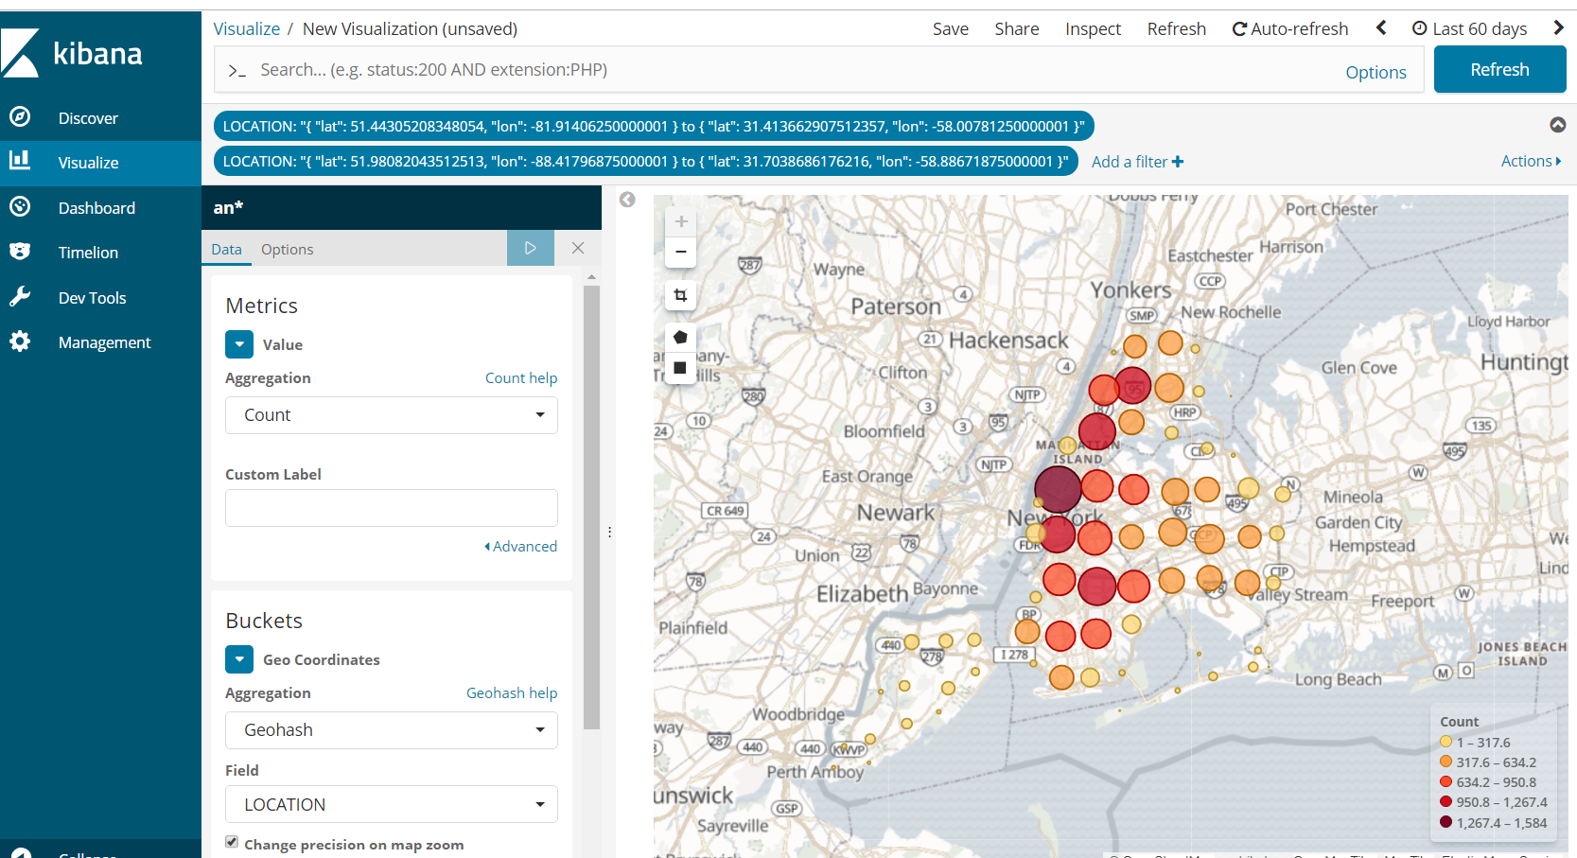
Locations Where Incidents Occurred Using Geo Points

Slide 5
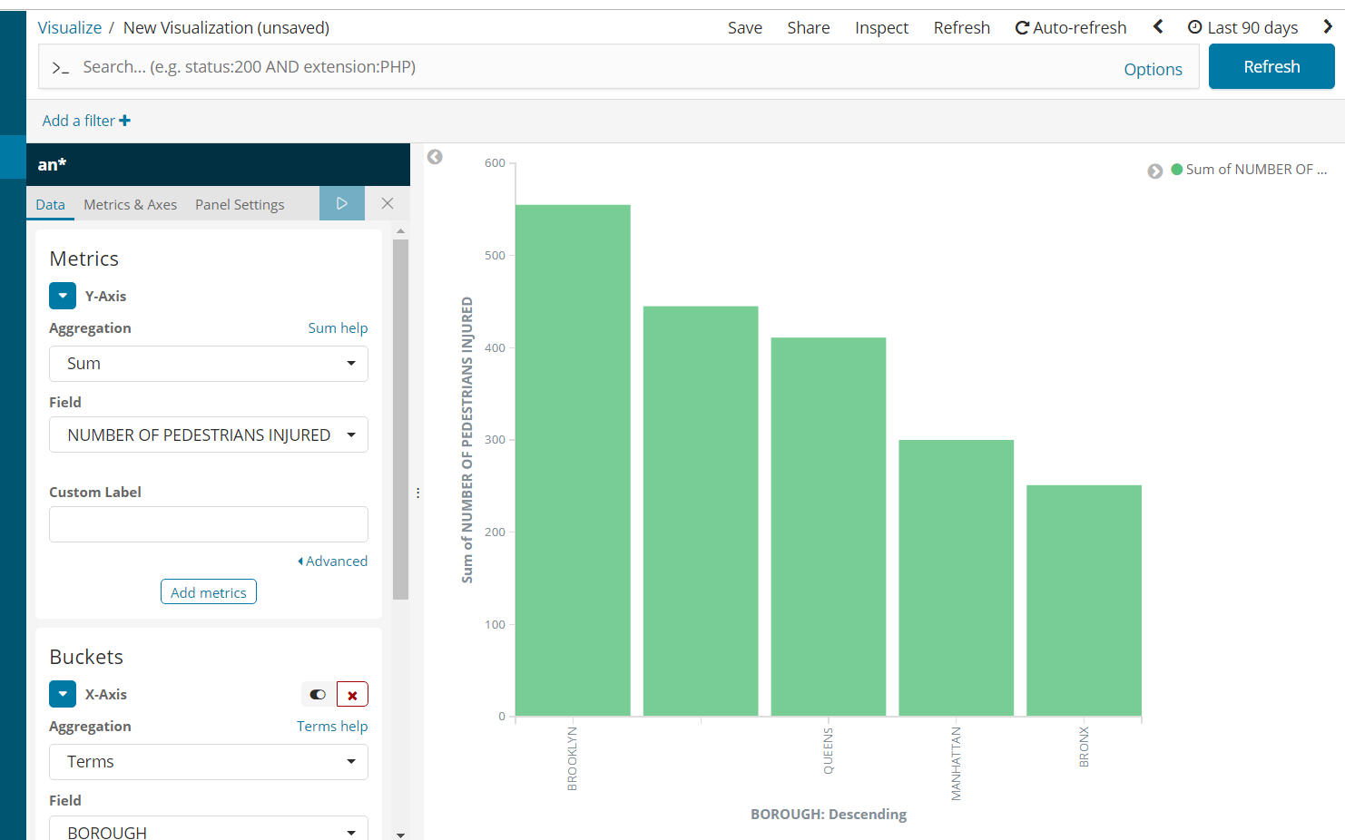
Total Number of Pedestrians Injured in Different Cities In New York

Slide 6
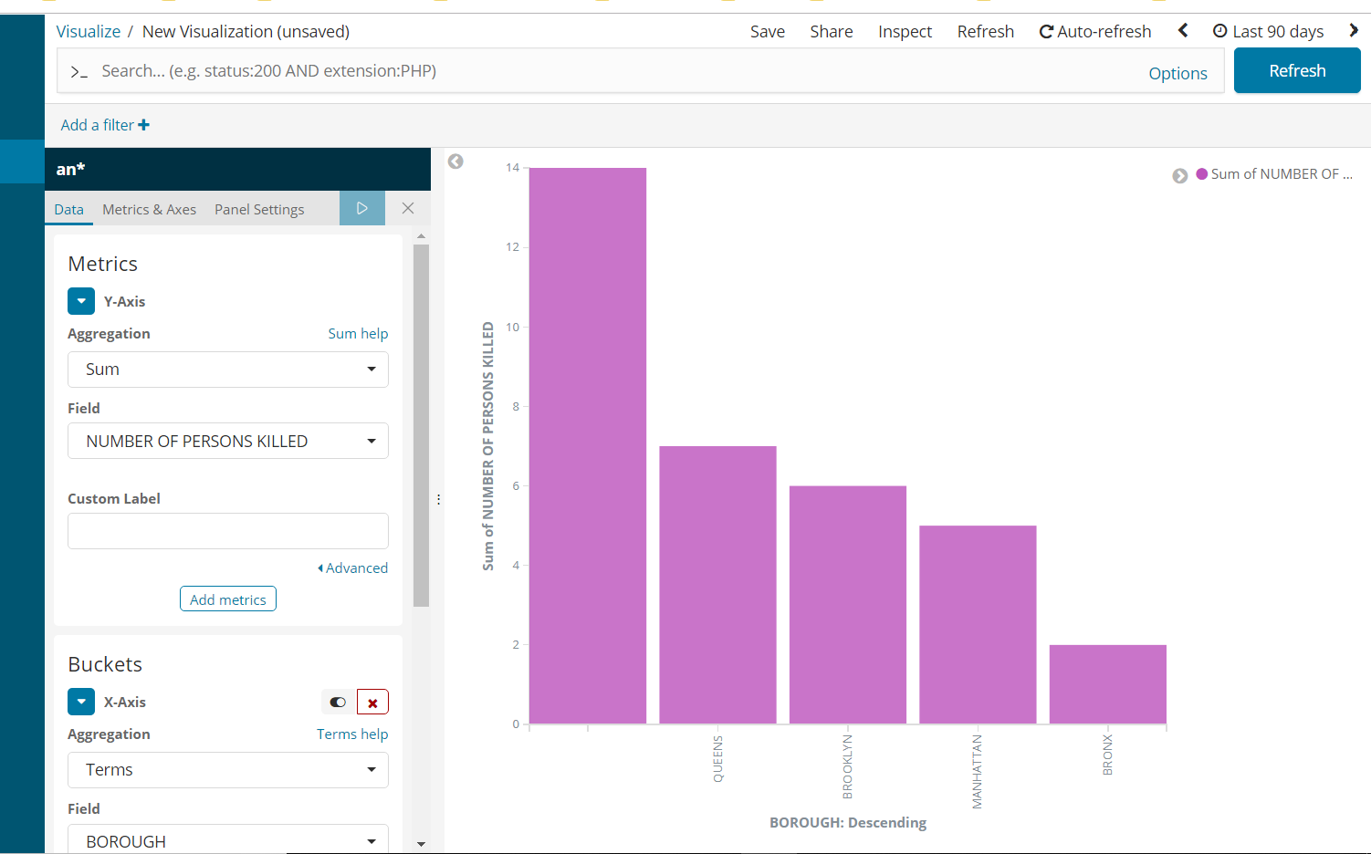
Total Number of Pedestrians Killed in Different Cities In New York

Slide 7
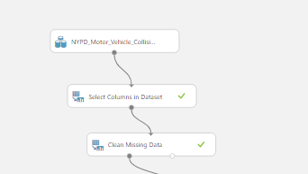
Data Engineering
Dataset has 29 columns
Selected columns:
Date,
Borough(City),
LATITUDE,
LONGITUDE,
NUMBER OF PERSONS INJURED,NUMBER OF PERSONS KILLED
Cleaning Missing Value

Slide 8
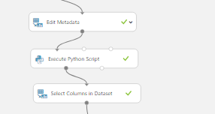
Data Engineering
Use Edit Metadata
Making Numeric Column Integer:
Number of Persons Injured ,Number of Persons Killed

Slide 9
Data Engineering
Use Python script to sum up number of injured people and killed people
Make new column named: Number of People Harm or Injured

Slide 10

Data Engineering
Normalize Numeric Column
change the values of numeric columns in the dataset to use a common scale
Make String Column Categorical

Slide 11
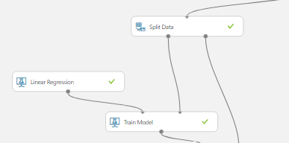
Train Model With Linear Regression
Split Data to Train Model
Using Linear Regression to Train Model
We Use Linear Regression Because It is Continuous Value

Slide 12
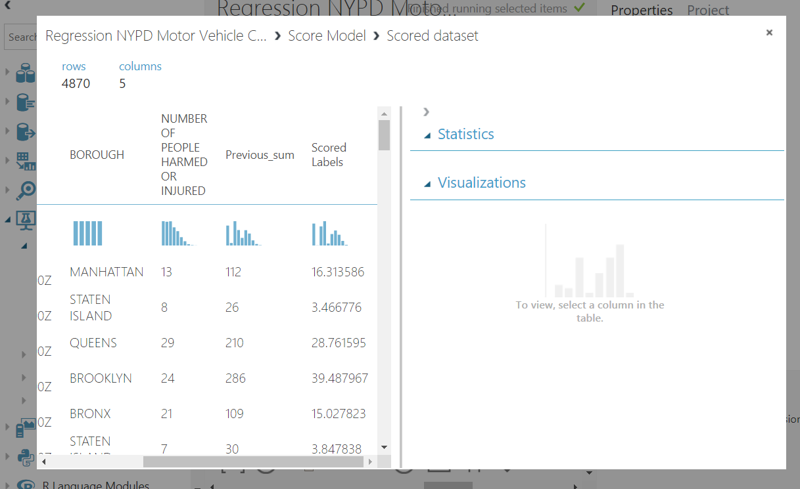
Predicted Value VS Actual Value Using Linear Regression

Slide 13
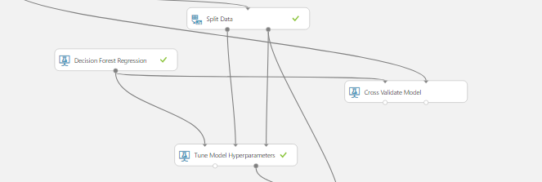
Train Model Using Decision Forest Regression
Split Data to train model
Tune Model Hyperparameter
Use Cross Validation to Improve Model

Slide 14
Train Model Using Decision Forest Regression
We use tune Hyperparameter
To perform a parameter sweep over the specified parameter settings, and learn an optimal set of hyperparameters
We use Cross validation with tuning
To divide data into folds and then build and test models on each fold
We try to improve our model

Slide 15
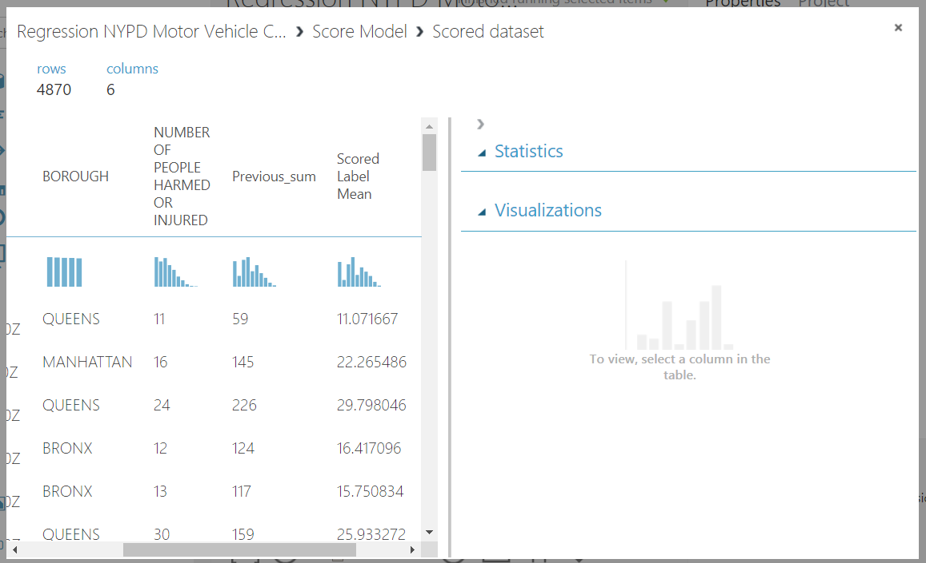
Predicted Value VS Actual Value Using Decision Forest Regression

Slide 16
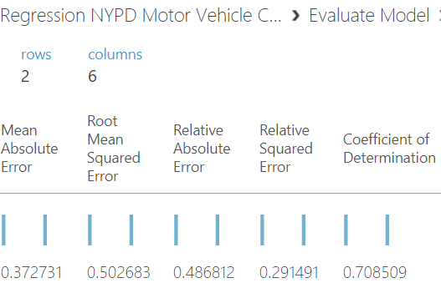
Linear Regression Result
Root Mean Square Error 0.5
Coefficient of Determination 0.7

Slide 17
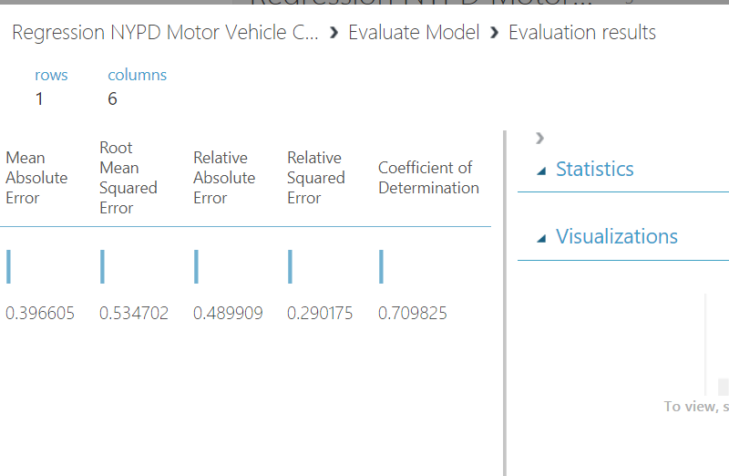
Decision Forest Regression result
Coefficient Of Determination 0.70
Root Mean Squared Error 0.53

Slide 18
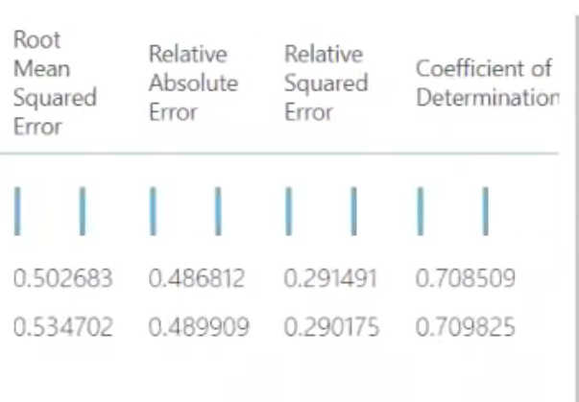
Linear Regression and Decision Forest Reg.
Linear Regression and Decision Forest Regression both had a “coefficient of determination” of 0.70, with only a slight variation of .1 %

Slide 19
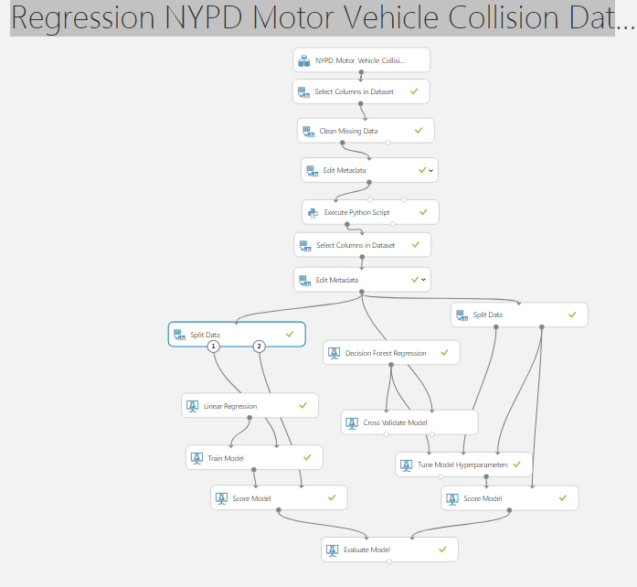
Our Whole Model
Regression NYPD Pedestrians Injured Dataset

